Slide 1
Foundation of Computer science
By : Mohamed Agami

Slide 2

Lecture 15

Slide 3
Disks, Partitions and File System

Slide 4
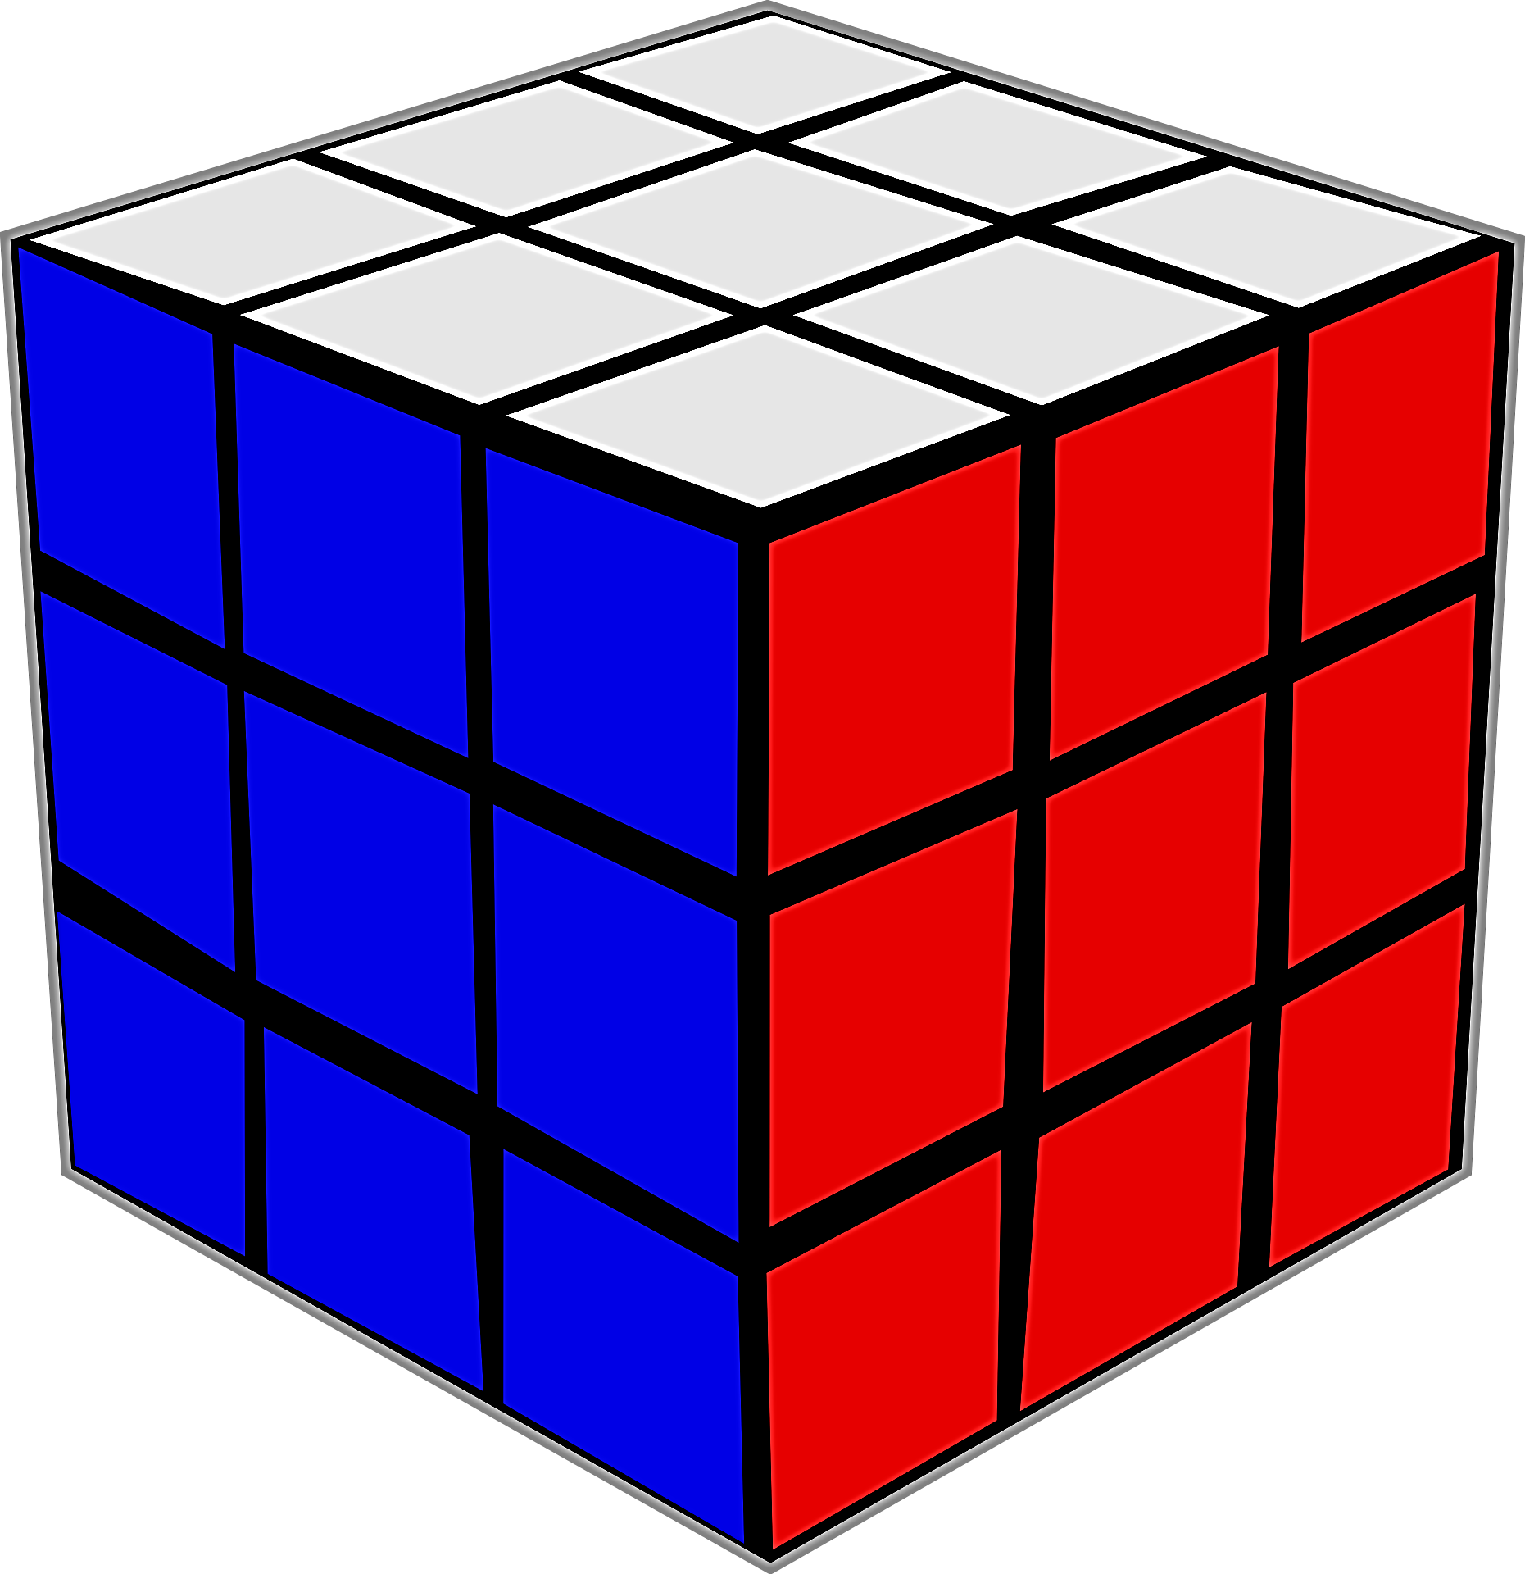
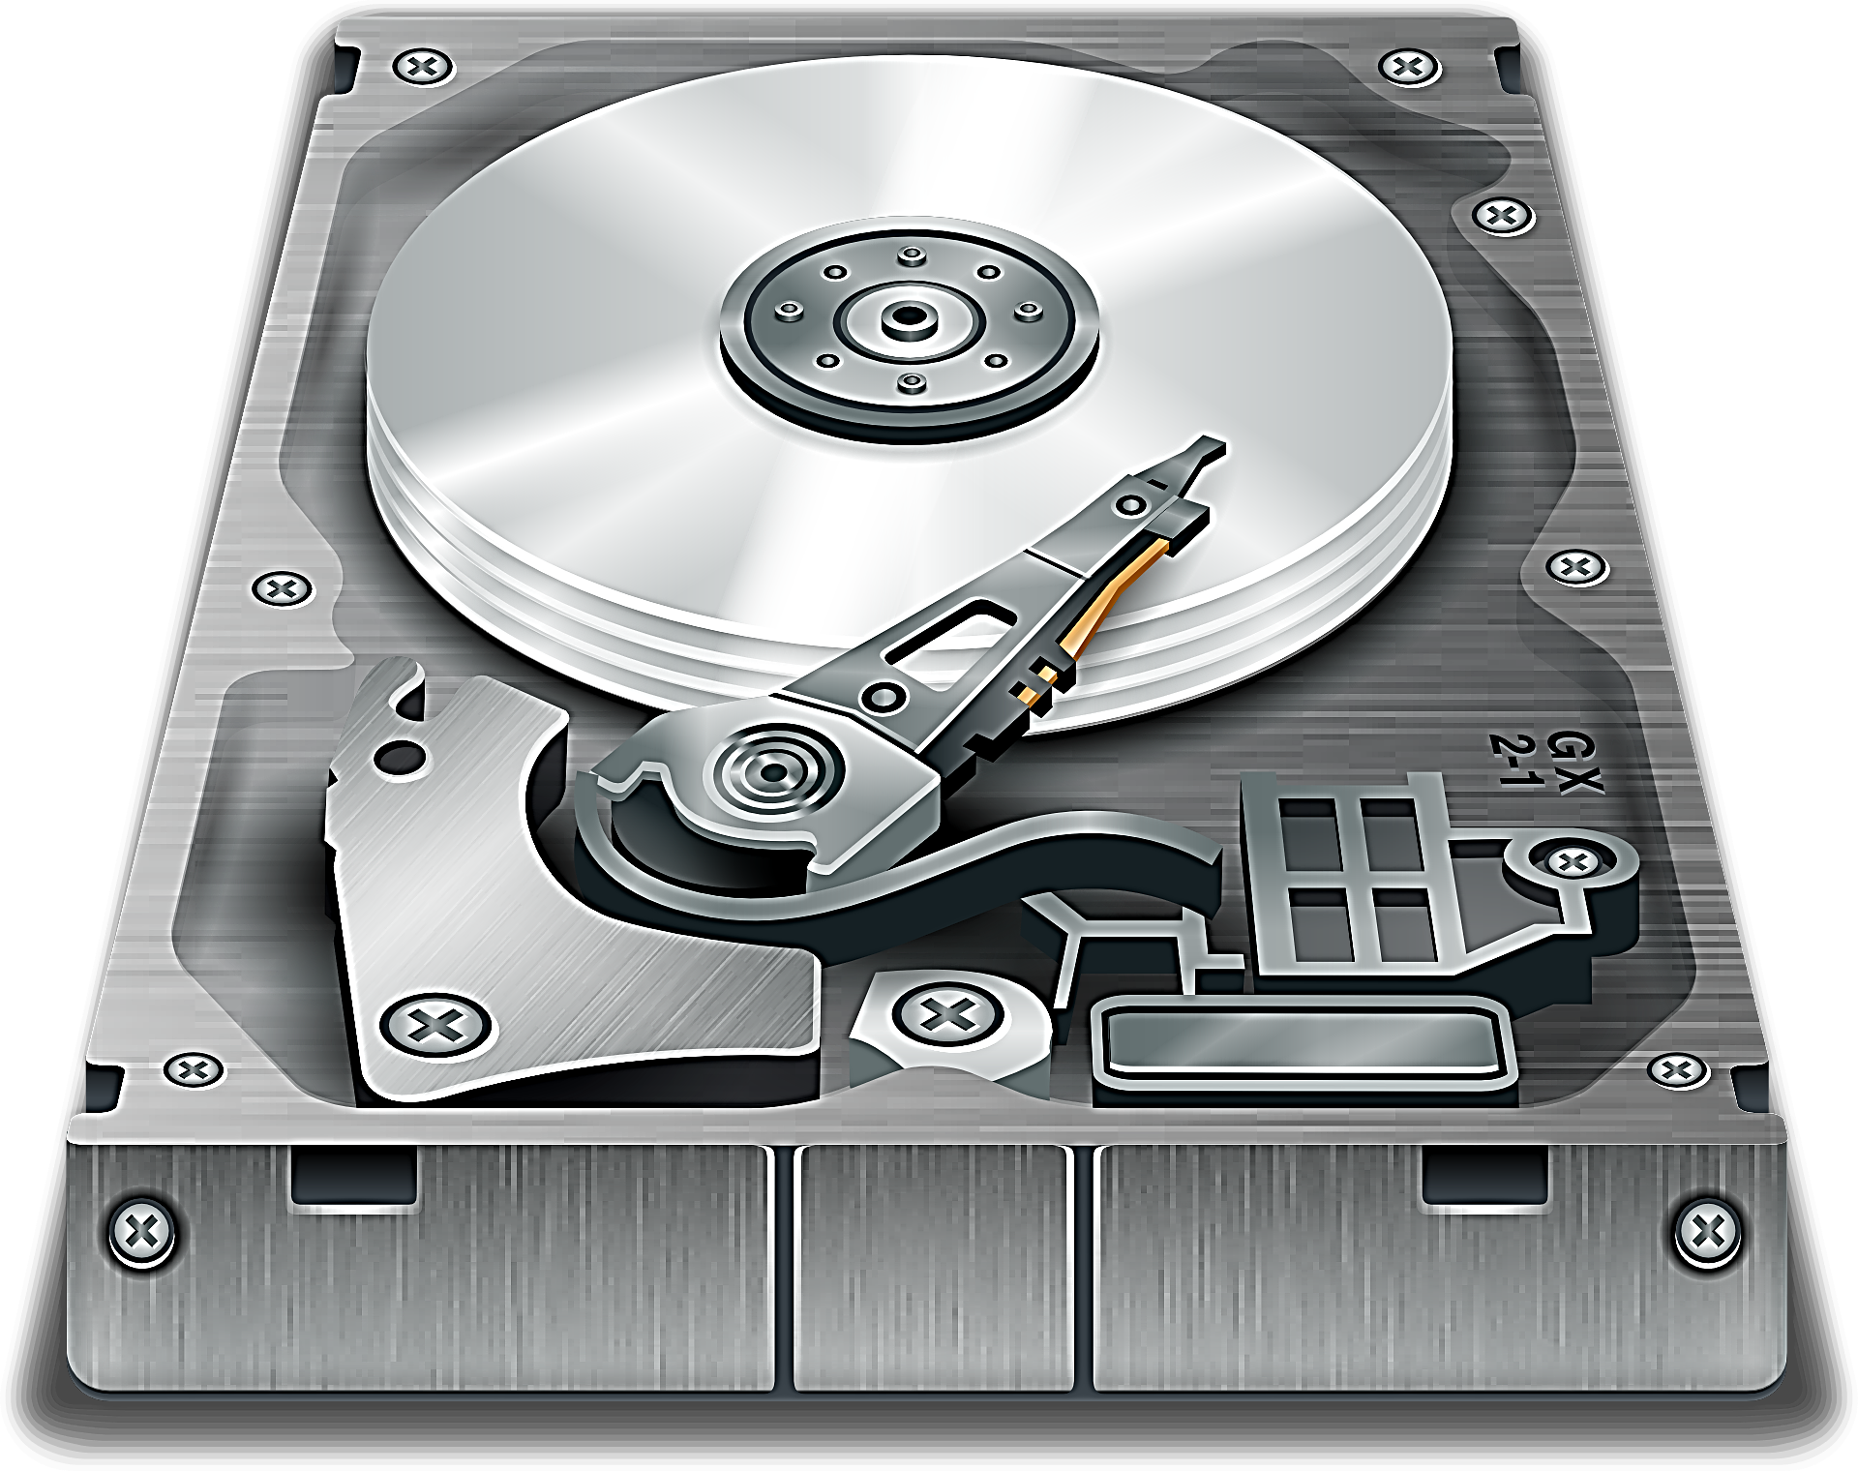
Understanding Disks, Partitions and volumes
Physical
Logical

Slide 5



Slide 6
MBR or GPT ?
Partitioning Scheme
1
Partitioning style
2
Partitioning system
3

Slide 7



MBR (master boot record)
Size: MBR is typically 512 bytes.
Limitations: MBR supports storage devices up to 2TB and allows up to four primary partitions.
Boot process: The BIOS reads the MBR to locate the boot loader for the operating system.

Slide 8
Primary
Primary
Primary
Extended

Slide 9




GUID Partition Table (GPT)
Size Support: GPT can handle disks larger than 2TB, unlike MBR, which is limited to 2TB.
Partition Limit: GPT allows an unlimited number of partitions (though most systems restrict it to 128 for compatibility), whereas MBR supports only up to four primary partitions.
Redundancy: GPT stores multiple copies of partitioning data at both the beginning and end of the disk, making it more robust against data corruption.
Data Integrity: GPT uses CRC (Cyclic Redundancy Check) for error detection, improving data integrity.

Slide 10
Protective MBR
Primary GPT Header: Partition Table
Backup of GPT Header: Copy of Partition Table

Slide 11
How to choose

Slide 12
Dynamic Disk
Allows for the creation of advanced volumes like RAID, spanning, and mirroring.
No fixed limit on the number of volumes but depends on available space.
Compatible only with newer versions of Windows.
Offers fault tolerance features like mirroring.
Basic Disk
A traditional type, supports up to 4 primary partitions (on MBR) or 128 partitions (on GPT).
No fixed limit on the number of volumes but depends on available space.
Compatible only with newer versions of Windows.
Does not provide fault tolerance features.

Slide 13
MBR + Basic Disk

Slide 14
Unlocated space
Partition
C:\
D:\
Volume
Format
F:\
E:\

Slide 15
Why we need to partition a disk ?
There are two main reasons:
Separate OS and Apps files from Users files
Dual-boot system

Slide 16
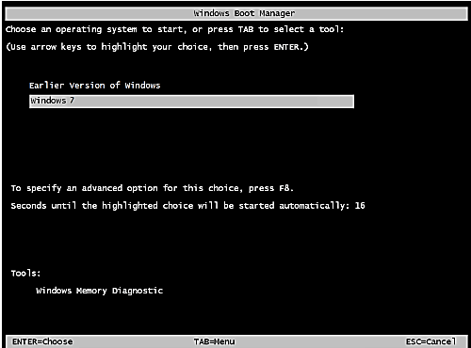
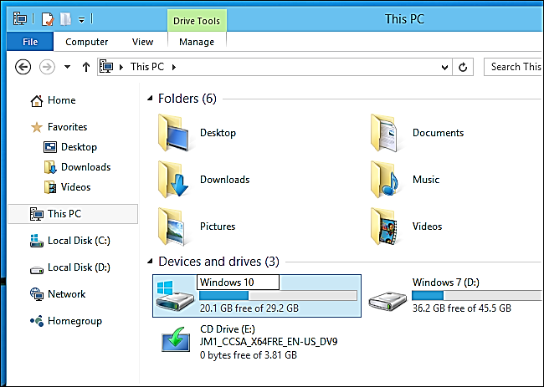
Dual-boot System

Slide 17
P
P
P
P
P
P
P
Primary Partition
P
P
P
E
Primary + Extended
P
P
P
E
LD 1
LD 2
LD 3
Primary + Extended

Slide 18

How Partitions Are Used during the Boot?
UEFI || BOIS
Active partition
(System partition)
Boot partition
D: \
E: \

Slide 19
How to do Disk Partitioning?
Built-in Windows Tools
GUI Tools(Disk Management)
CMD Tool(Disk Part)

Slide 20
Practical example

Slide 21
Basic Disks Vs. Dynamic Disks
Feature | Basic Disk | Dynamic Disk
Partition Types | Primary, Extended, Logical | Simple, Spanned, Striped, Mirrored, RAID 5
Number of Volumes | Limited to 4 primary or 3 primary + 1 extended | Unlimited number of dynamic volumes
Fault Tolerance | No fault tolerance | Supports RAID 1 (mirroring) and RAID 5
Performance | Standard | Supports RAID 0 (striping) for performance boost
OS Support | Most OS (Windows, Linux, etc.) | Limited to Windows OS
Management | Simpler, suitable for basic needs | More complex but offers advanced configurations

Slide 22
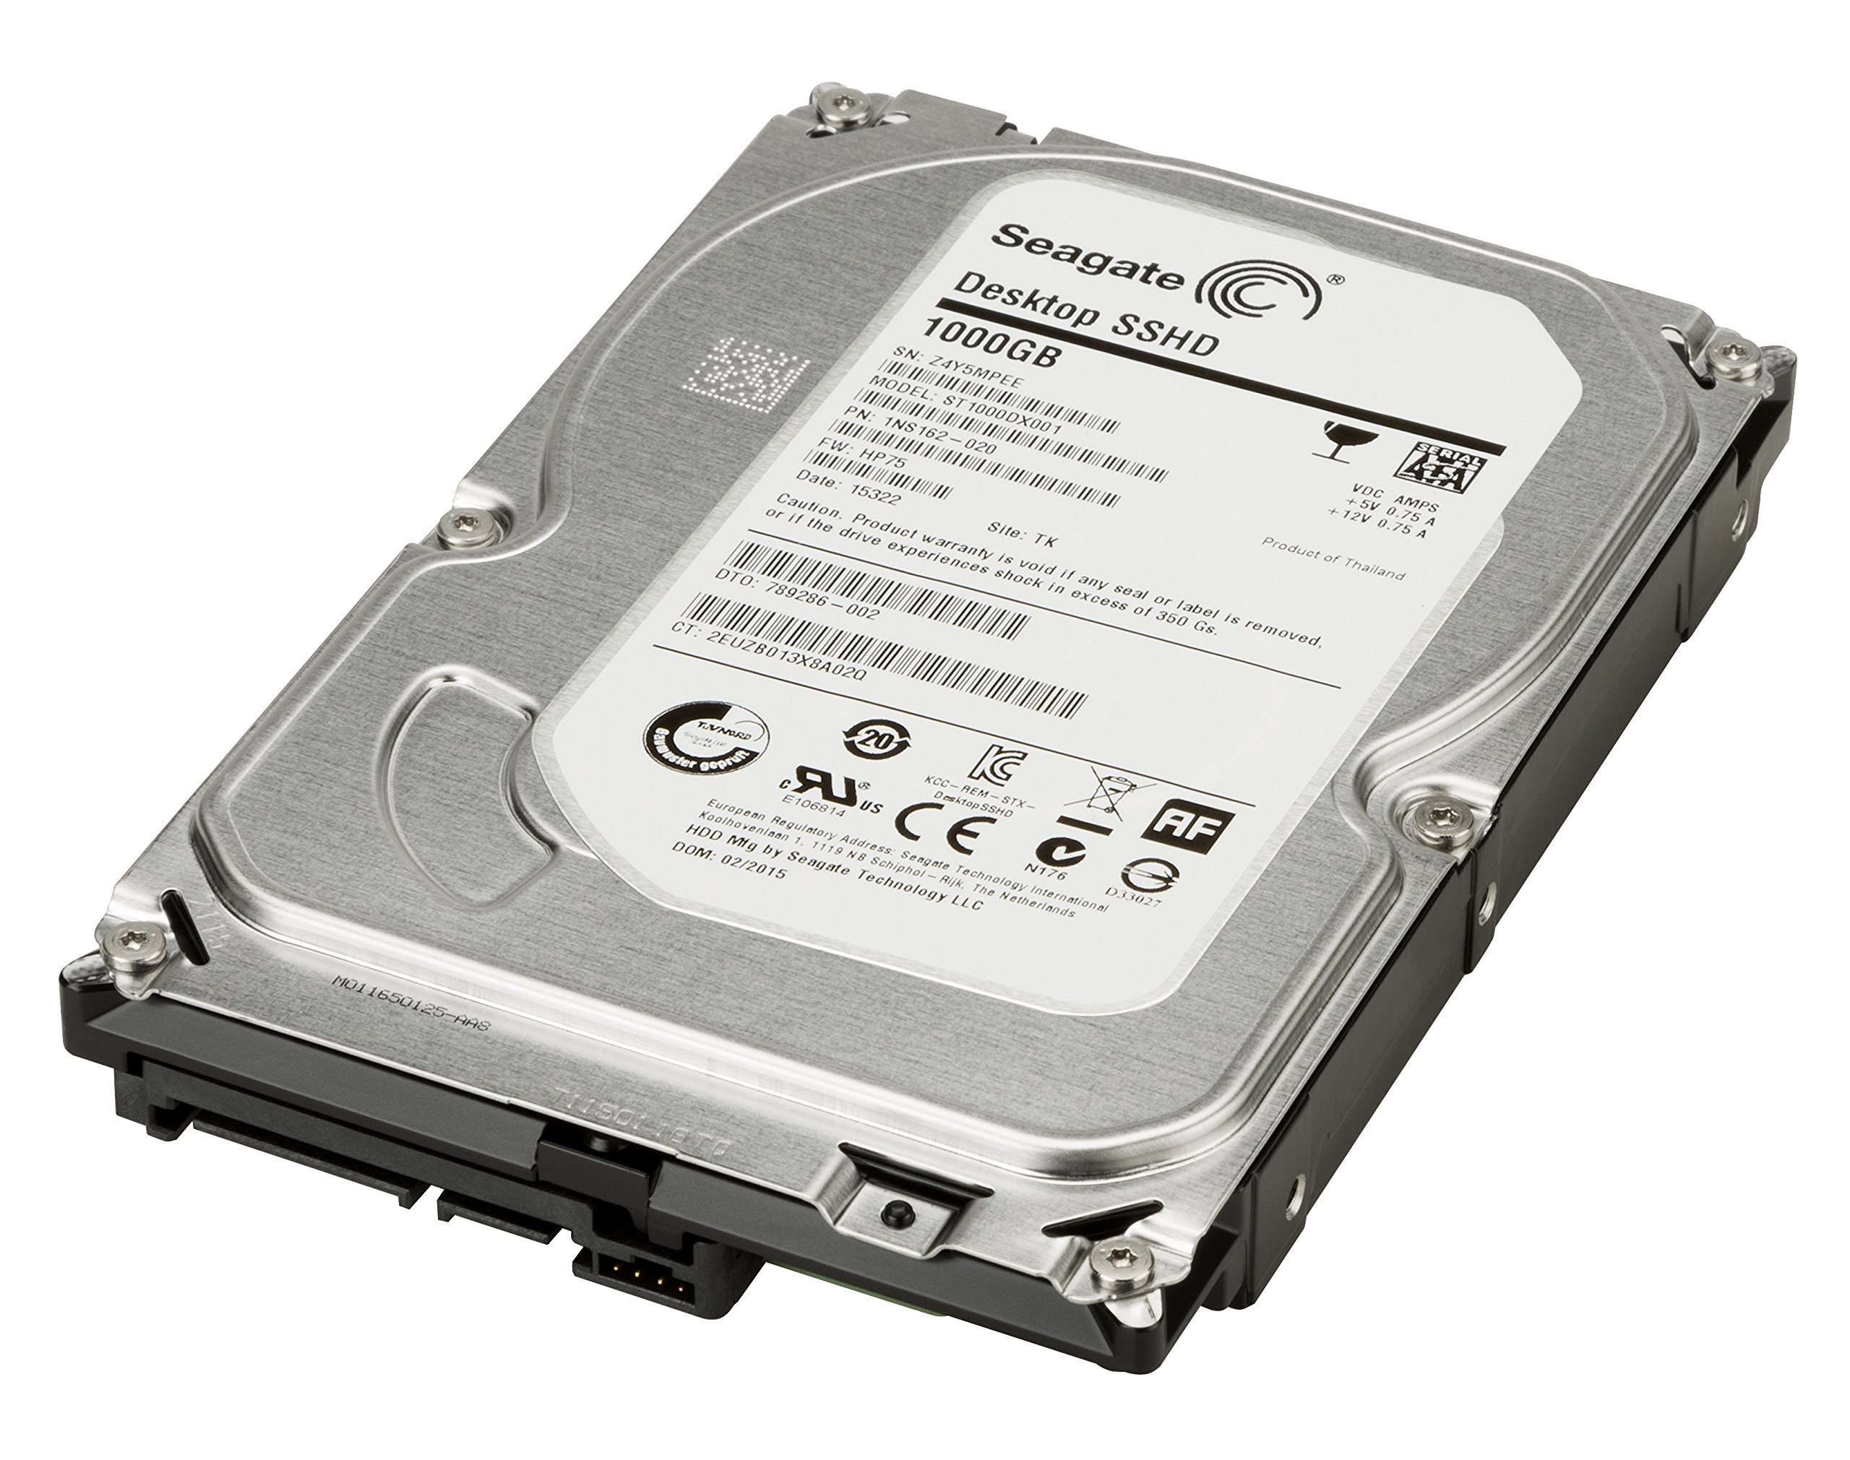
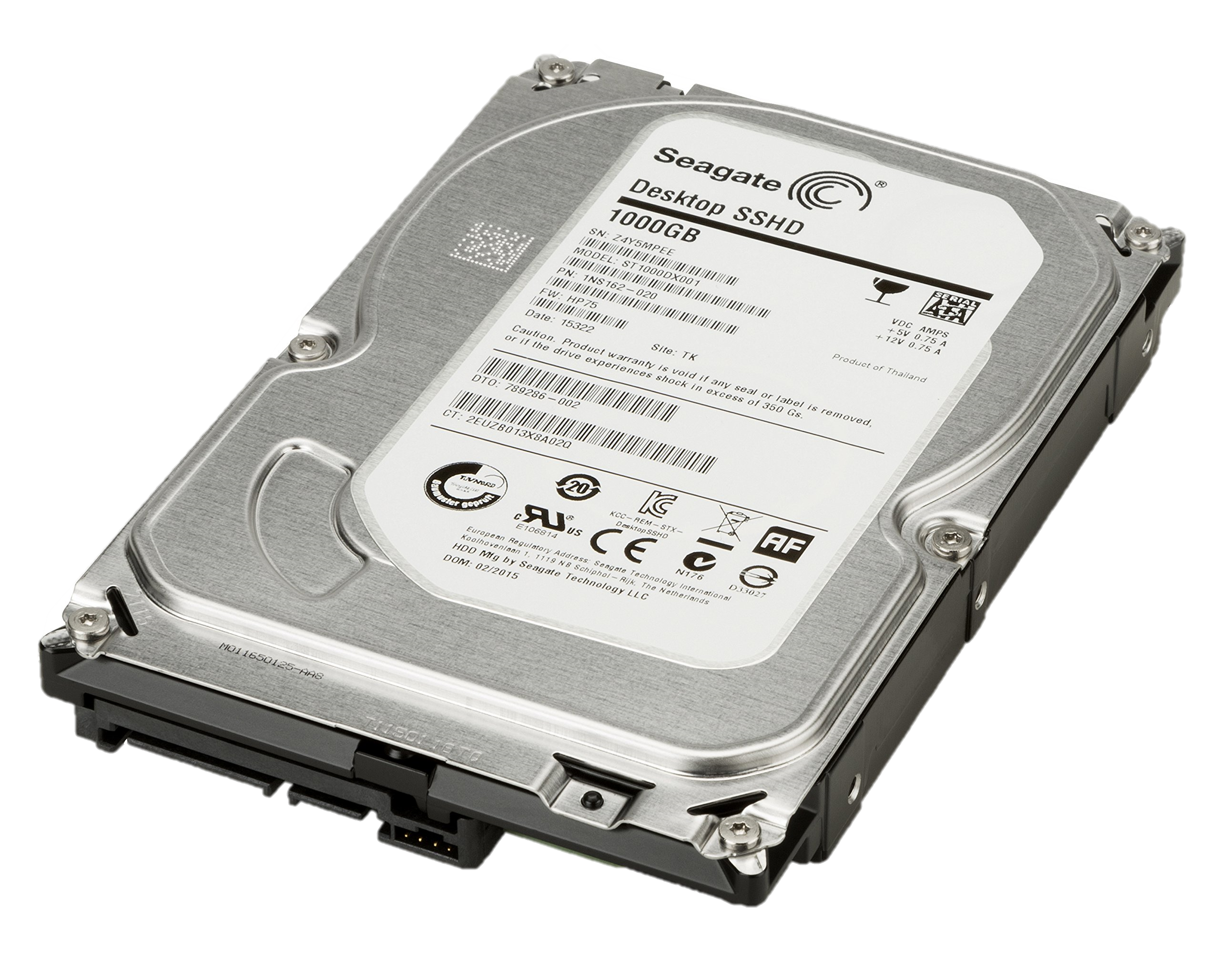
partitions
Partitions
Basic disk
Dynamic Disk

Slide 23
RAID
+ dynamic disk
(Redundant Array Of Independent Disks)

Slide 24
RAID (Redundant Array of Independent Disks)
RAID is a virtual data storage technology that combines multiple physical drive components into one or more logical units. The primary goal of RAID is to improve data redundancy and performance.

Slide 25

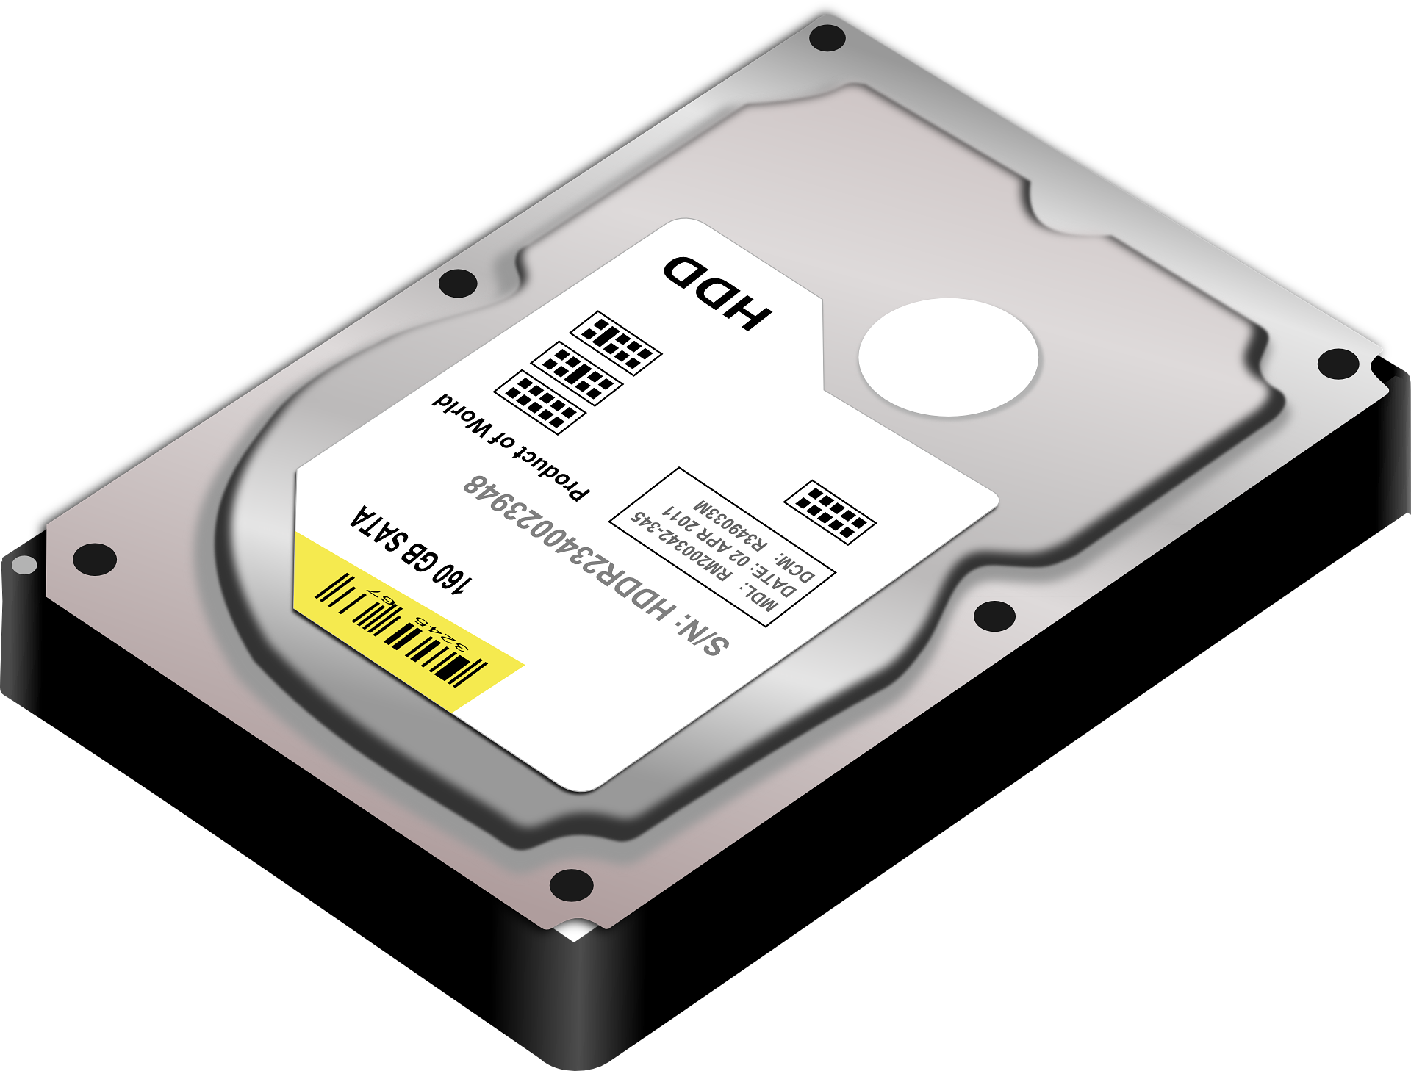
RAID Concepts
1-Striping
Logical hard disk
Advanced : R / W speed
Dis Advanced : Fault tolerance

Slide 26
RAID Concepts
2-Mirroring
Logical hard disk
Advanced : Fault tolerance
Dis Advanced : R / W Speed

Slide 27
RAID Concepts
3-Duplexing
Advanced : R / W speed
Dis Advanced : Fault tolerance

Slide 28
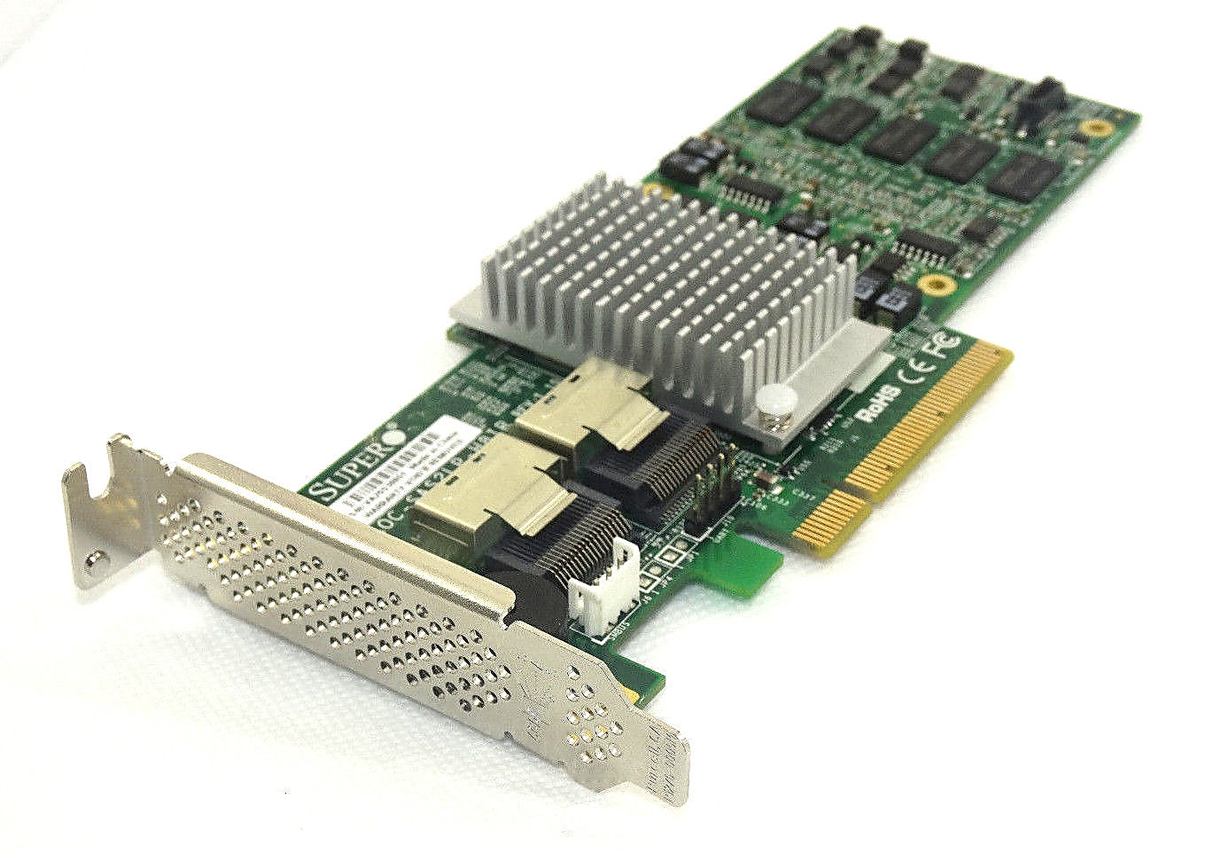

Hardware REID Software REID

Slide 29
RAID Levels
RAID 0
Striping
RAID 1
Mirroring
RAID 5
Striping with Parity
RAID 6
Striping with Double Parity
RAID 10
RAID 1+0

Slide 30
REID level 0
1-Striping
Logical hard disk
Advanced : R / W speed
Dis Advanced : Fault tolerance

Slide 31
RAID level 1
2-Mirroring
Logical hard disk
Advanced : Fault tolerance
Dis Advanced : R / W Speed

Slide 32
RAID level 5
Striping with Parity
D
A
T A
☑
☑
Disk 1
Disk 2
Disk 3
parity
parity
parity

Slide 33
RAID level 10
RAID 0
RAID 1 && 0
RAID 1
RAID 1
RISK 2
RISK 3
RISK 4
RISK 1

Slide 34
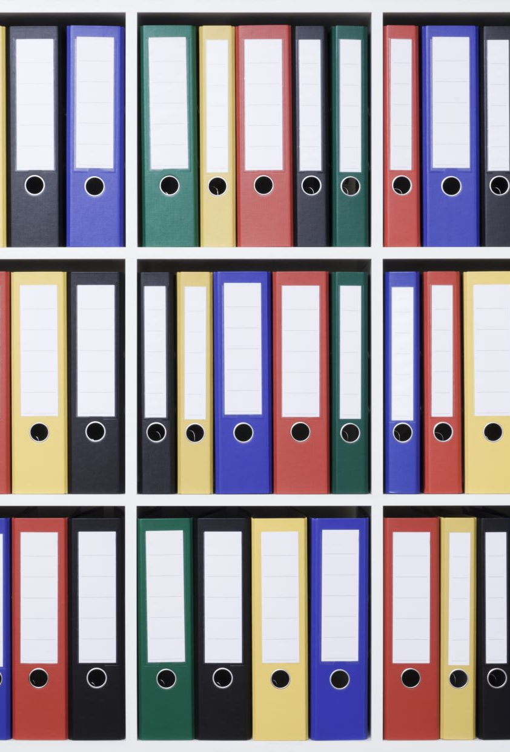
File System

Slide 35
HDD
Partitions style
MBR || GPT
Partitions
Format (file system)

Slide 36

File System
A file system is used to organize files and folders so that the operating system can access the files.

Slide 37

Understanding Clusters

Slide 38
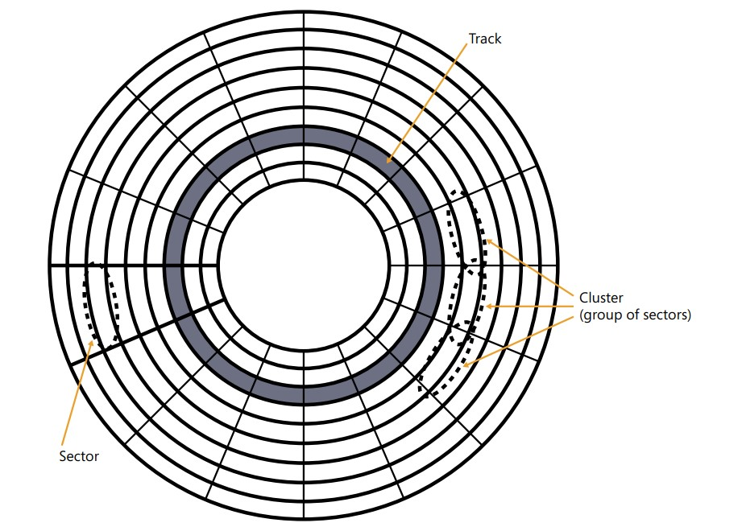

Slide 39
File system
FAT 32
NTFS

Slide 40

FAT (File Allocation Table)
Simple, older file system.
Limited to smaller file sizes (up to 4GB for FAT32).
Common in USB drives and smaller storage devices due to wide compatibility.
File1 | File 2 | File 3
018x | 025x | 064x
026x | 065x | 086x

Slide 41
NTFS (New Technology File System
Advanced, modern file system.
Supports large file sizes and more advanced features like file permissions, encryption, and compression.
Commonly used in internal hard drives and SSDs in Windows systems.
MFT
File1 | File 2 | File 3
018x | 025x | 064x
026x | 065x | 086x

Slide 42
Feature | FAT (File Allocation Table) | NTFS (New Technology File System)
Introduction Date | 1977 (FAT12), 1980 (FAT16), 1996 (FAT32) | 1993
Maximum File Size | 4 GB (FAT32), 2 GB (FAT16) | Virtually unlimited (up to 16 TB for a single file)
Maximum Partition Size | 32 GB (FAT32), 2 GB (FAT16) | 256 TB (theoretical max is much larger)
File Compression | Not supported | Supported
Encryption | Not supported | Supported (EFS - Encrypting File System)
File Permissions | Not supported | Supported (ACL - Access Control List)
Recovery Features | Very basic | Advanced (transaction log, auto-recovery)
Fault Tolerance | Low | High (journaling to protect data integrity)
Security | No security features | Advanced security features (encryption, permissions)
Compatibility | High (supports many OS and devices) | Primarily for Windows, limited compatibility with other systems
Use Case | USB drives, memory cards, legacy systems | Internal drives for Windows systems (HDD/SSD)

Slide 43
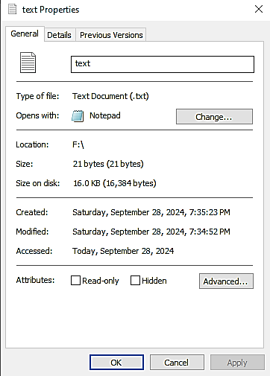
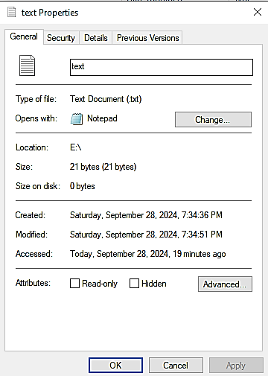

Slide 44
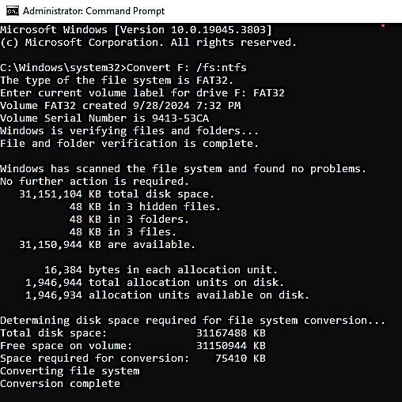
Practical application of Encryption Quota

Slide 45

Tank you

